Slide 1
Rom. 8:5
“For those who are according to the flesh set their minds on the things of the flesh, but those who are according to the Spirit, the things of the Spirit.”

Slide 3
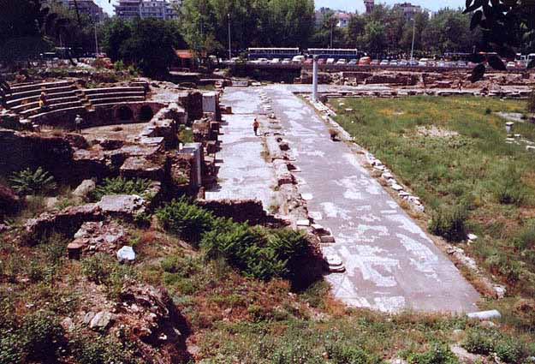
Spirituality How to Measure It
A Look at the Spirituality of the
THESSALONIANS

Slide 4
John 3
Jesus Speaks Spiritually
One Must Be Born Again.
That Which Is Born of Spirit is Spirit.
Nicodemus Only Understands the Flesh
How Can A Man Go Back to His Mother’s Womb.
That Which Is Born of Flesh is Flesh

Slide 5
1 Cor 2:14
“But a natural man does not accept the things of the Spirit of God; for they are foolishness to him, and he cannot understand them, because they are spiritually appraised.”

Slide 6
Rom 8:5
“For those who are according to the flesh set their minds on the things of the flesh, but those who are according to the Spirit, the things of the Spirit.”

Slide 7
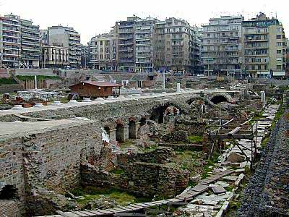
Acts 17:1-5, 10
Paul had to leave long before he wanted to.
1 Thess. 3:1-8 – Paul shows his concern for them.

Slide 8
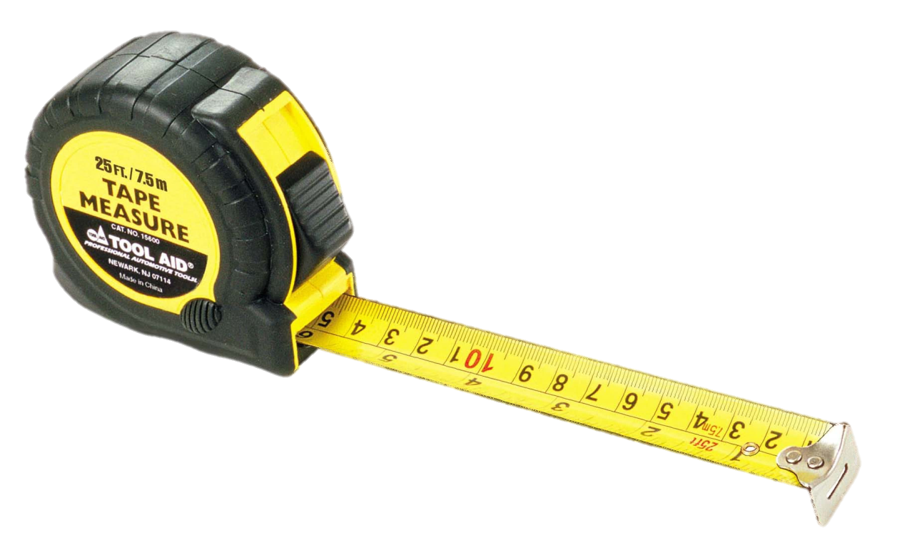
How Did Paul Measure Their Spirituality
Timothy Sent to Find Out About Their FAITH (5).
Timothy Reported Good News About Their FAITH and LOVE (6).

Slide 9
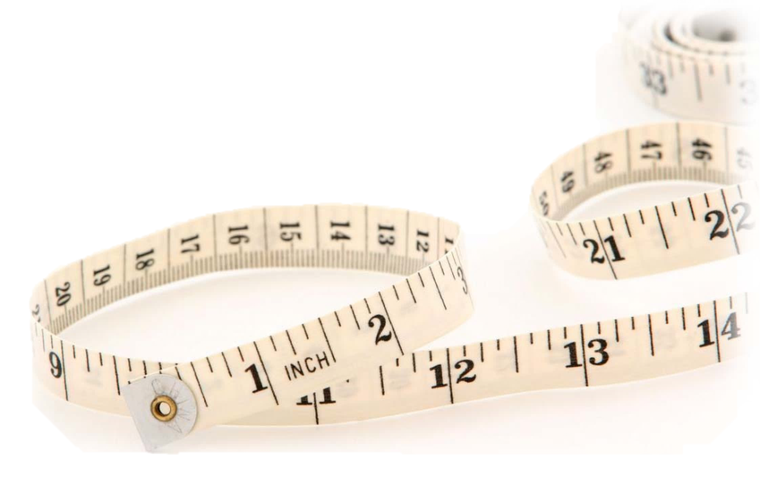
How Did Paul Measure Their Spirituality
1 Thess. 1:2-3
Paul Gave Thanks For Their…
Work of FAITH
Labor of LOVE
Steadfastness of HOPE.

Slide 10
1 Thess. 5:8
“But since we are of the day, let us be sober, having put on the breastplate of faith and love, and as a helmet, the hope of salvation.”

Slide 11
Faith, Hope, Love
1 Cor. 13:13
Rom. 5:1-5
Eph. 1:15-16
Col. 1:3
Philemon 1:4-5

Slide 12
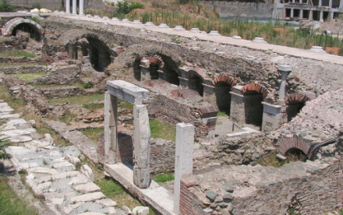
Faith and Love
1 Cor. 13:2
Gal. 5:6
Eph. 3:17; 6:23
2 Thess. 1:3
1 Tim. 1:5; 2:15; 4:12; 6:11
Faith and Hope
Gal. 5:5
Col. 1:23
1 Pet. 1:21

Slide 13
